Slide 1
Chapter 28- Appendix 1

Slide 2
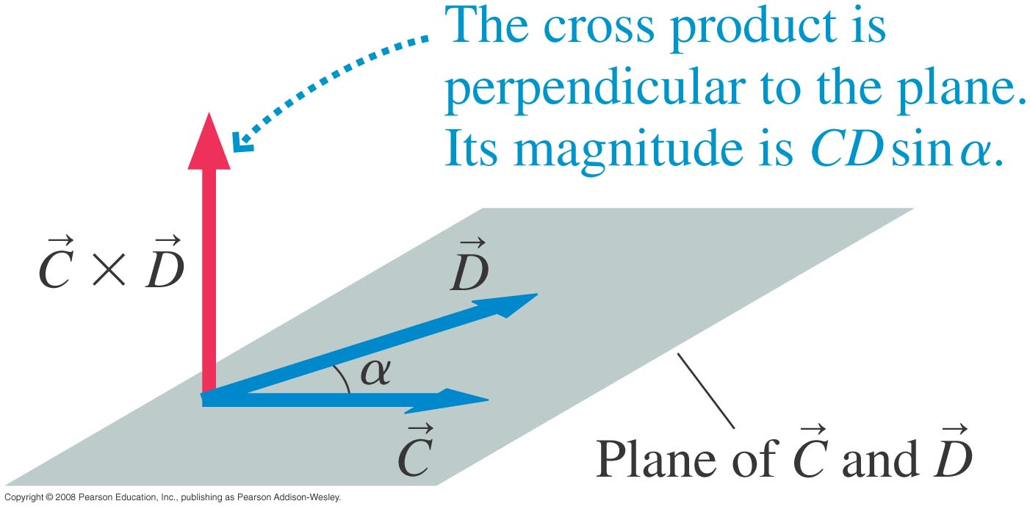
The Vector Cross Product
Point the fingers of your right hand along the first vector in the cross product (vector C), then curl them so they point along the second vector (vector D). Your thumb gives the direction of the cross product.

Slide 3
Cross product vs regular product
Regular/dot product
Cross product
Distributive
Distributive
Commutative
Anticommutative
Associative
Non-Associative

Slide 4
Unit vector notation
The cross product becomes easy to deal with when using unit vector notation
Now let’s see what the cross product between A and B is:

Slide 5
Another way to think about it
Start with the two vectors in component form
The cross product is given by the determinant of the following matrix:

Slide 6
Parallel and Perpendicular vectors
For parallel vectors
For perpendicular vectors

